Slide 1
Discrete Structures
Spring 2020
l3uesnu
National University of Computer and Emerging Sciences, Islamabad

Slide 2
Discrete Structures
Online course content & coordination
Google classroom

Slide 3
Text book and reference material
Discrete mathematics with Applications
By Susanna S.EPP
Discrete mathematics and its applications
by Kenneth H. Rosen

Slide 4
Grading Criteria (Marks Distribution)
Tentative grading criteria is as follows:
Quizzes (10%)
Assignments (15%)
Mid Term Exam (20%)
Project (15%)
Final Exam (40%)

Slide 5
Class Policy
Don’t come late.
I will not mark present if you come after ten min.
No retake of Quiz.
Most Quiz were unannounced.

Slide 6
Discrete Structures
Study of mathematical structures and objects that are fundamentally discrete rather than continuous
Examples of objects with discrete values are integers , graphs or statements in logic .
Discrete mathematics and computer science
Concepts from discrete mathematics are useful for describing objects and problems in computer algorithms and programming languages . These have applications in cryptography.

Slide 7
The various aspects of discrete mathematics form the foundation for:
designing programs and algorithms
reasoning about programs and algorithms
solving real-world problems using the computer in particular, solving problems in information technology , i.e. problems involving computers, communication, information.

Slide 8
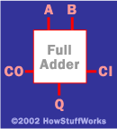
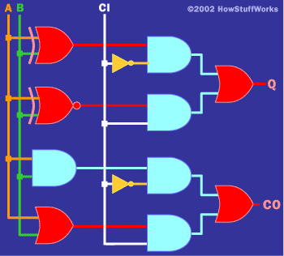
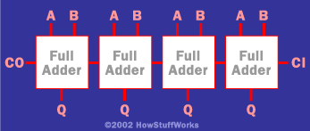
Logic: Hardware and software specifications
Formal: Input_wire_A
value in {0, 1}
One-bit Full Adder with
Carry-In and Carry-Out
Example 1: Adder
4-bit full adder

Slide 9
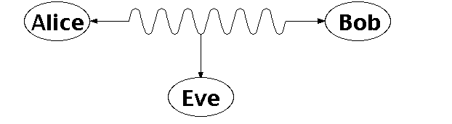
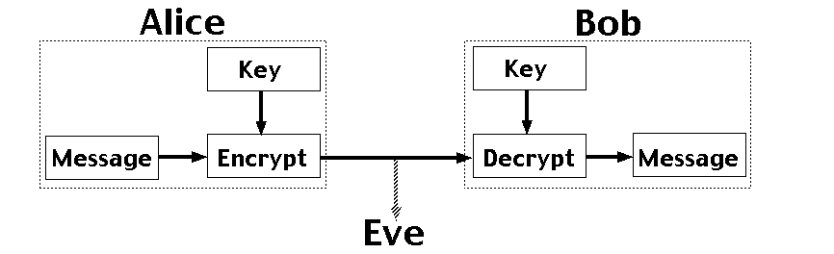
Number Theory: RSA and Public-key Cryptography
Alice and Bob have never met but they would like to
exchange a message. Eve would like to eavesdrop.
E.g. between you and the Bank of America.
They could come up with a good encryption algorithm and exchange the encryption key – but how to do it without
Eve getting it? (If Eve gets it, all security
is lost.)
CS folks found the solution:
public key encryption. Quite remarkable
that that is feasible.
Notes:
One solution is for Alice and Bob to exchange a digital key, so they both know it, but it's otherwise secret. Alice uses this key to encrypt messages she sends, and Bob reconstructs the original messages by decrypting with the same key. The encrypted messages (ciphertexts) are useless to Eve, who doesn't know the key, and so can't reconstruct the original messages. With a good encryption algorithm, this scheme can work well, but exchanging the key while keeping it secret from Eve is a problem. This really requires a face to face meeting, which is not always practical.

Slide 10
Graphs and Networks
Many problems can be represented by a graphical network representation.
Examples:
Distribution problems
Routing problems
Maximum flow problems
Designing computer / phone / road networks
Equipment replacement
And of course the Internet
Aside: finding the right
problem representation
is one of the key issues.

Slide 11
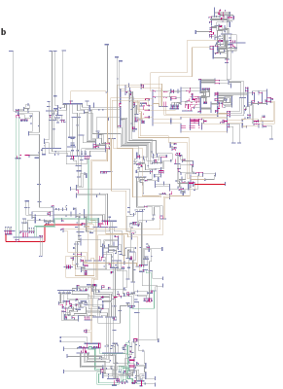
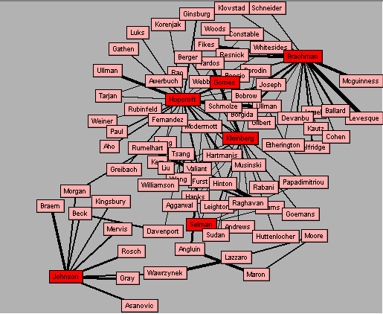
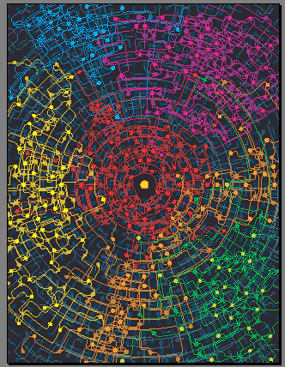
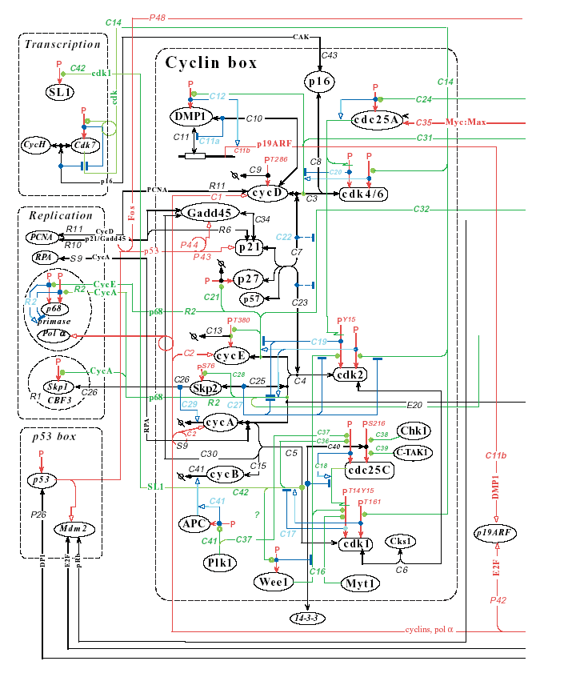
New Science of Networks
Networks are
pervasive
Utility Patent network
1972-1999
(3 Million patents)
Gomes,Hopcroft,Lesser,Selman
Neural network of the
nematode worm C- elegans
(Strogatz, Watts)
NYS Electric
Power Grid
(Thorp,Strogatz,Watts)
Network of computer scientists
ReferralWeb System
(Kautz and Selman)
Cybercommunities
(Automatically discovered)
Kleinberg et al
Notes:
Networked or linked structures are ubiquitous. Examples range from the World Wide Web, large social networks such as the network of board of directors or the network of Hollywood actors, the distribution network of Wal-Mart, the power grid of the US, or even the neurological network of our brain.
August 96 - Major power outage that affected the entire west coast of the US from Alaska to California for over 24 hours.
This power outage was caused by a single transmission line,
That was knowcked down by a tree. More interestingly, the accident
Was detected right away and as standard procedure the load of the line
Was transferred to the other lines of the set; but they were already overloaded
And the extra overload caused the lines to heat up stretch. Well, this was a hot
Summer, the trees had grown dramatically and a few lines were kncked down,
Causing the domino effect that brought down the entire power grid of
The west coast of the US.
How did it happened? Key issues:
How can we design more robust netwroks?
How does disease spread in a ntewrokd of people
Graphs that occur in many biological, social, and manmade systems
Are often neither completely regular nor completely random –
Instead they have a small world topology ➔ nodes are highly clustered
And yet the path length between them is small

Slide 12
Applications of Networks
Applications
Physical analog of nodes
Physical analog of arcs
Flow
Communication systems
phone exchanges,
computers,
transmission
facilities, satellites
Cables, fiber optic
links, microwave
relay links
Voice messages, Data, Video transmissions
Hydraulic systems
Pumping stations Reservoirs, Lakes
Pipelines
Water, Gas, Oil, Hydraulic fluids
Integrated computer circuits
Gates, registers, processors
Wires
Electrical current
Mechanical systems
Joints
Rods, Beams, Springs
Heat, Energy
Transportation systems
Intersections, Airports, Rail yards
Highways, Airline routes Railbeds
Passengers,
freight,
vehicles,
operators

Slide 13
Probability and Chance
Importance of concepts from probability is rapidly increasing in CS:
Randomized algorithms (e.g. primality testing; randomized search algorithms, such as simulated annealing, Google’s PageRank, “just” a random walk on the web!) In computation, having a few random bits really helps!
Machine Learning / Data Mining: Find statistical regularities in large amounts of data. (e.g. Naïve Bayes alg.)

Slide 14
Tentative Syllabus
Logic: propositional logic, logical equivalence, predicates & quantifiers, and logical reasoning.
Sets: basics, set operations
Functions: one-to-one, onto, inverse, composition, graphs
Integers: greatest common divisor, Euclidean algorithm.
Sequences and Summations
Mathematical reasoning: Proof strategies, Mathematical Induction, Recursive definitions, Structural Induction
Counting: basic rules, Pigeon hall principle, Permutations and combinations, Binomial coefficients and Pascal triangle.
Relations: properties, Combining relations, Closures, Equivalence, partial ordering
Graphs , directed, undirected graphs.

